Slide 1

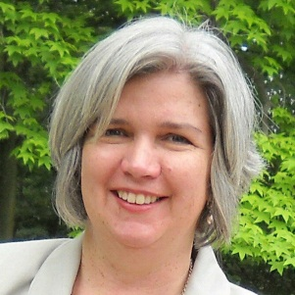
Low Cost/No Cost Solutions for Health Activities
In Your UCEDD
Michael Fox
David O’Hara
Elena Andresen
Eileen Sparling

Slide 2
Low Cost/No Cost Solutions for Health Activities in Your University Center for Excellence in Developmental Disabilities (UCEDD)
Surveillance Tools
Michael H. Fox, Sc.D.
Acting Director
Division of Human Development and Disability
Centers for Disease Control and Prevention
November 19th, 2013
National Center on Birth Defects and Developmental Disabilities
Division of Human Development and Disability

Slide 3

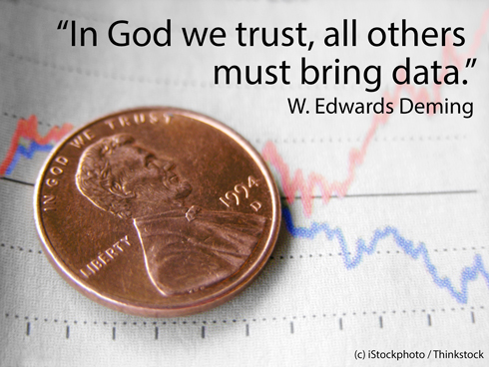
Data?
Who Needs Data?
Statistics are like bikinis. What they reveal is suggestive, but what they conceal is vital.
— Aaron Levenstein, Business Professor at Baruch College
Politicization of Science in the Public Sphere: A Study of Public Trust in the United States, 1974 to 2010. Gordon Gauchat; American Sociological Review 2012 77: 167

Slide 4
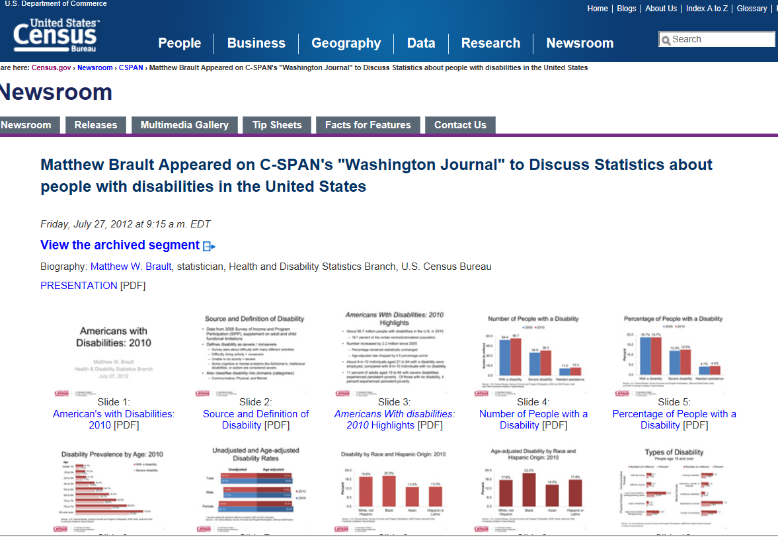
Where Do We Begin to Look?
Big Picture Stuff
What does the Census have? Great national level reports that illustrate health differences at the national level.
http://www.census.gov/#

Slide 5
How is Disability Defined Using Census Data?
The ACS identifies serious difficulty with four basic areas of functioning – hearing, vision, cognition, and ambulation.
These functional limitations are supplemented by questions about difficulties with selected activities from the Katz Activities of Daily Living (ADL) and Lawton Instrumental Activities of Daily Living (IADL) scales, namely difficulty bathing and dressing, and difficulty performing errands such as shopping. Overall, the ACS attempts to capture six aspects of disability, which can be used together to create an overall disability measure, or independently to identify populations with specific disability types.
http://www.census.gov/acs/www/Downloads/data_documentation/SubjectDefinitions/2012_ACSSubjectDefinitions.pdf

Slide 6
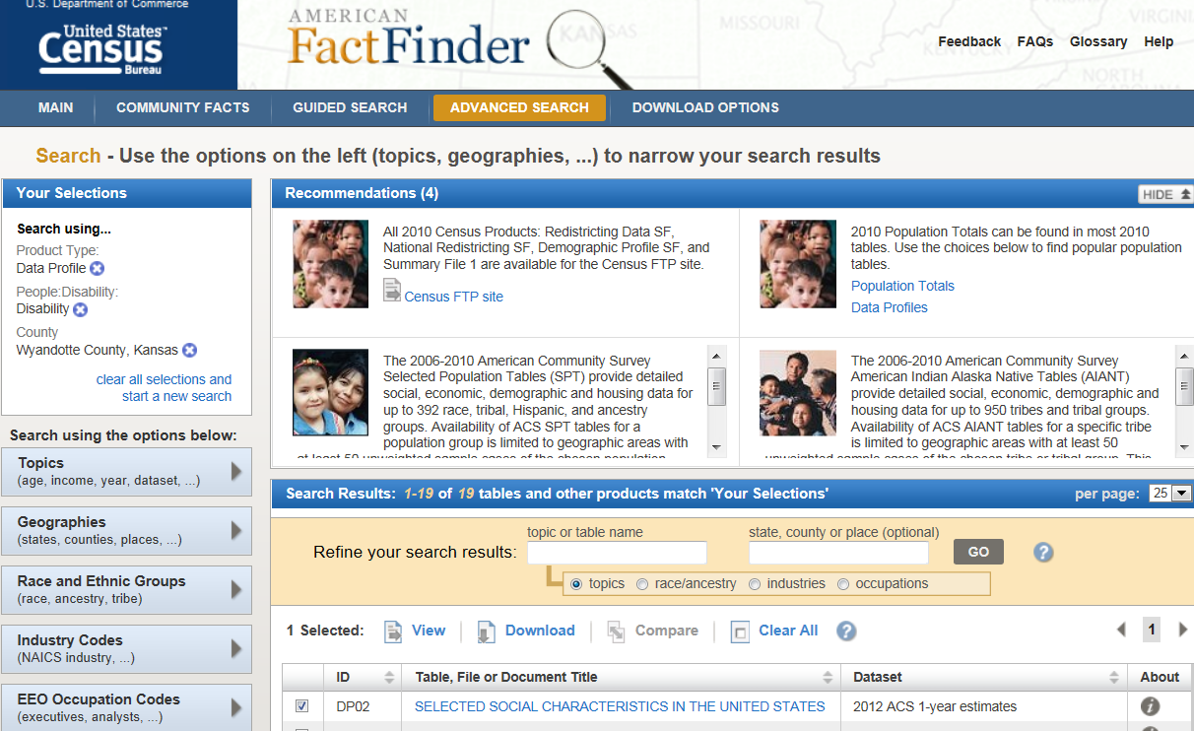
Question:
Can We Break These Down to State, County, Local or Census Tract Level?
YES!
Great Query System
http://factfinder2.census.gov
Notes:
Tract data will be added in 2014
Limited ability to break things out by state

Slide 7
So Why Not Just Use Census Data?
“The Federal Government collects extensive survey and administrative data pertaining to disability that is used by federal agencies for a variety of purposes. However, existing national disability-related survey and administrative data are limited in their ability to meet the needs of (federal) programs and policy makers. Such limitations include inadequate and inconsistent measures of disability, small sample sizes or no data on particular subpopulations of interest, lack of information on specific topics, very limited longitudinal information, poor-quality survey data on program participation and service use, and lack of access to and linkages with administrative data (Livermore and She 2007).”
http://aspe.hhs.gov/daltcp/reports/2011/DDNatlSur.pdf

Slide 8
Other Federal Surveys Identifying People with Disabilities http://aspe.hhs.gov/daltcp/reports/2011/DDNatlSur.pdf

Slide 9
One Way to Use Survey Data for Decision Support
CDC’s Disability
and Health Data
System - DHDS
http://dhds.cdc.gov/

Slide 10
What is the Disability and Health Data System (DHDS)?
An interactive state level disability and health data tool developed and maintained by the CDC, Division of Human Development and Disability
An on-line system that allows comparisons of health data for adults with and without disabilities
  Easy way to identify differences in health between the two
  A starting point for research, program development, and policy development
A way to access timely, standardized, and reliable health data
  Allows for consistent comparison
  Is updated annually with most recent data
Notes:
So, what is DHDS?
DHDS is a publicly available interactive online data tool, which provides state level health data on adults with and without disabilities. It allows users to easily identify health areas in which adults with disabilities are experiencing disparities in health.
It is a reliable information source, providing timely, standardized, and consistent health data that is updated annually.

Slide 11
Examples of Questions That Can Be Answered Using DHDS…
What is the percentage of adults with disabilities in each state?
What state has the highest percentage of adults with disabilities who are current smokers?
What is the percentage of obesity among people with disabilities in each state, and how does that compare across age, sex, and race/ethnicity categories?
How is your state performing across a variety of health indicators, such as vaccine coverage and preventive services, for people with disabilities compared with people without disabilities?
Many more…
Notes:
DHDS can be used to explore many types of questions on the health of adults with disabilities across the country.
For example,
You could find out the percentage of adults with disabilities in a state...
You could find out which state has the highest percentage of people with disabilities who are current smokers...
You could find out find out the percentage of adults with disabilities who are obese in each state, and further examine that by age, sex, and race/ethnicity…
You could find out how a particular state is doing across a range of health topics, and in which health topics are there large disparities between adults with and without disabilities.
These are all questions that can be answered with DHDS, and today we will focus mainly on how to answer the last question

Slide 12
What Data are in DHDS?
Behavioral Risk Factor Surveillance System (BRFSS) data
  2004 – 2011, updated annually
  Analyzed to show data by disability status
    8 demographics
    62 health topics
Psychological distress status information
Disability-associated health care expenditures
* Citations, references, and credits
Notes:
The data in DHS come from the Behavioral Risk Factor Surveillance System (BRFSS). The BRFSS is a state-based survey that collects comprehensive demographic, health condition, health risk behavior, and preventive health data on the U.S. civilian noninstitutionalized population 18 years of age or older.
We keep the system up to date with the most recent data, so currently DHDS has information from 2004-2011. BRFSS health data are analyzed by disability status. This means that the health data are shown among adults with and without disabilities, and allows for easy identification of health disparities. For example, you can view the percentage of adults with disability in Georgia who smoke, and also compare that to the percentage of adults without disability in Georgia who smoke.
There are also some health topics available by psychological distress status, and we also have disability associated health care expenditures.

Slide 13
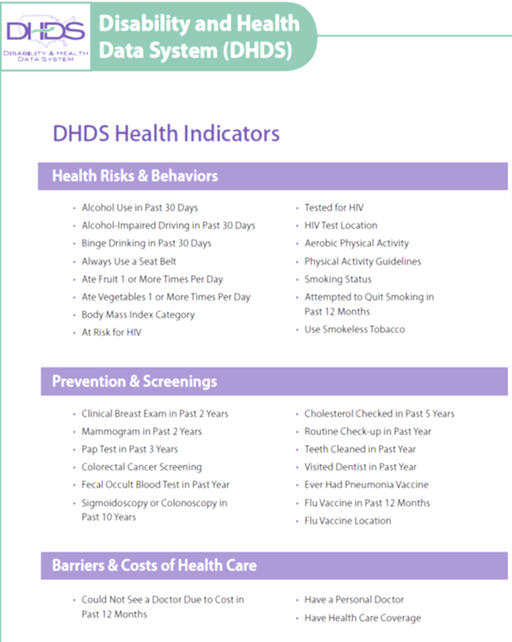
What Health Data are in DHDS?
62 indicators
Organized into 7 categories:
  Health Risks & Behaviors
  Prevention & Screenings
  Barriers & Costs of Health Care
  General Health Conditions
  Chronic Conditions
  Injuries
  Mental & Emotional Health
Notes:
On the last slide I showed that we have 8 demographics and 62 health topics currently available in DHDS.
I wanted to give you a quick overview of the health topics that we have. They are organized into these 7 categories [READ]. And I will show you in more detail when I get into the demo.

Slide 14
How to View Data in DHDS ?
Maps & Data Tables
  Data by topic
  View a single indicator at a time for all states in an interactive map or data table
State Profiles
  Data by state
  View data for one state across multiple indicators
Notes:
The data in DHDS can be viewed in two ways - by topic and by state.
Maps & Data Tables show data by topic – this shows data on one health topic across all states, through an interactive map or a data table.
State Profiles show data by state – this shows data across many health topics at one time, for just one state.

Slide 15
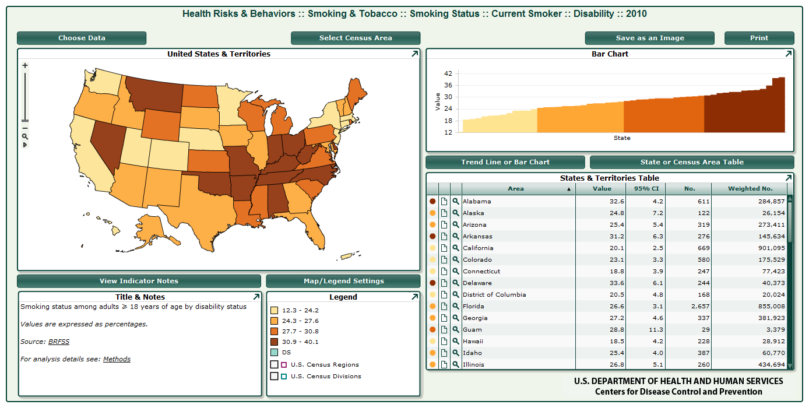
DHDS Maps
The Interactive Map is useful if you want to visually explore data values about one indicator for all areas. You can easily identify your state’s performance and compare it to others.

Slide 16
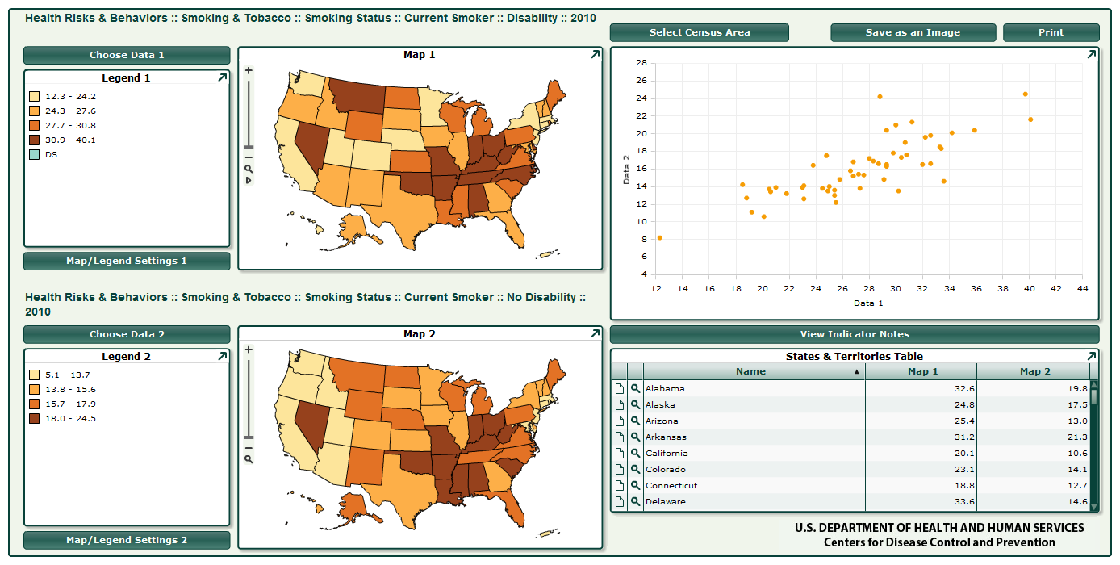
DHDS Maps
The Interactive Comparison Map is useful if you want to visually compare two pieces of information about one indicator for all areas, and view both pieces of data side by side in a table.

Slide 17
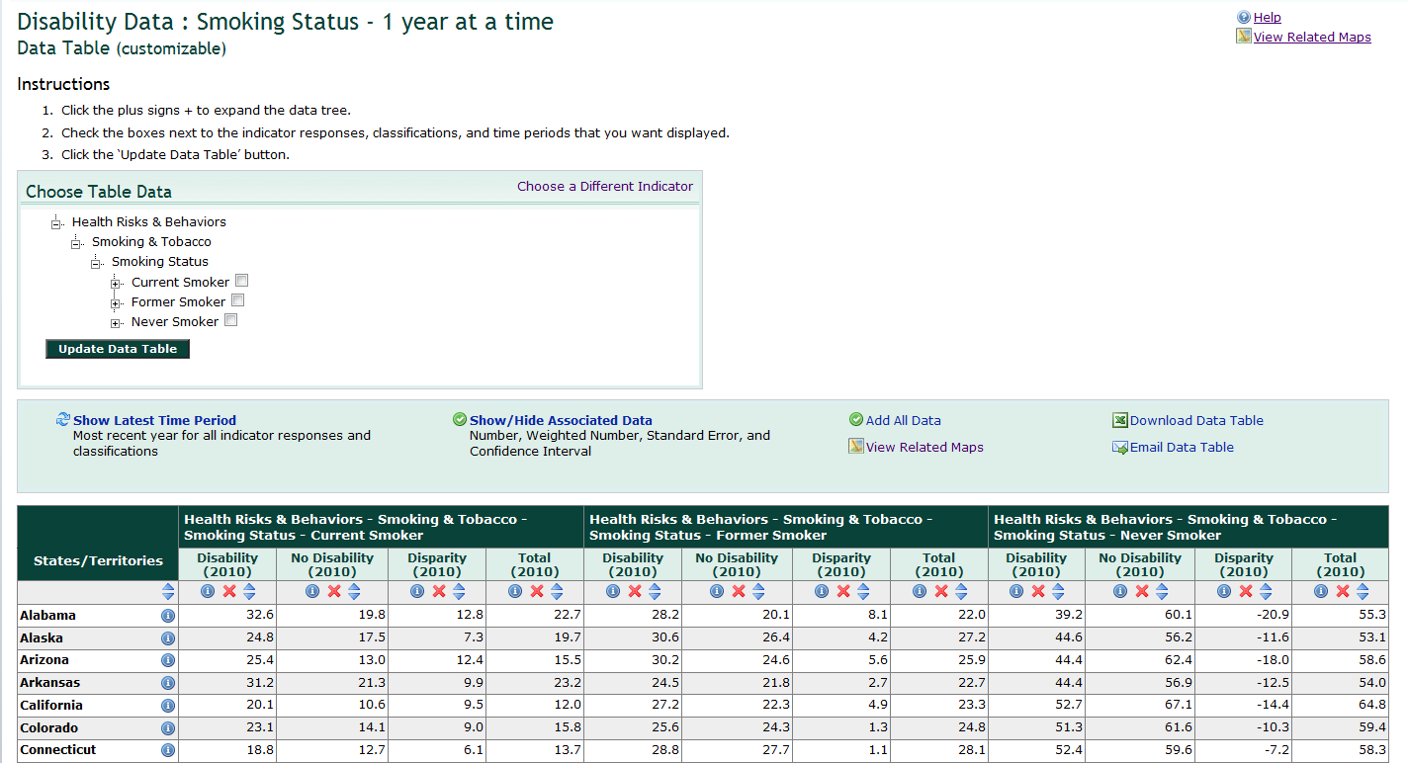
DHDS Data Tables
The Data Table (customizable) can be customized to include specific pieces of data for the selected indicator, including response levels, years, and associated data.

Slide 18
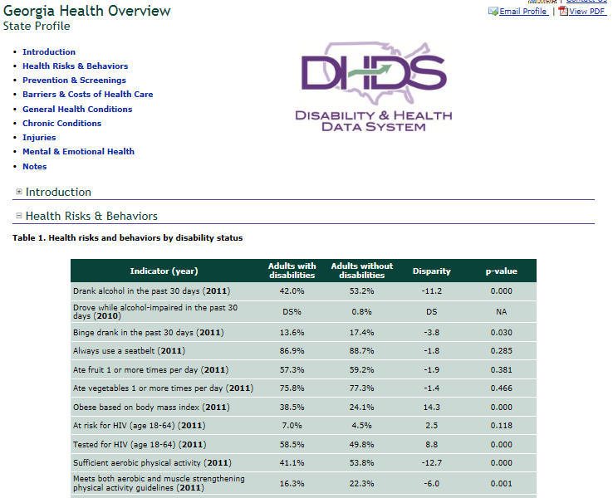
DHDS State Profiles
State Profiles are good to show data by state. You can view data for many health topics at one time for your state, comparing adults with and without disability.

Slide 19

DHDS Demo http://dhds.cdc.gov/
Notes:
Let’s demo the system. The URL is dhds.cdc.gov.
This is our home page. On the left side you see that there are several navigation links [quickly discuss].
Down the home page you see the two ways to view data that I mentioned – by indicator (topic), and by state
Further down the page you see that we have quick links to Key Topics – these link to interactive maps on these topic areas. The maps will show you the topic, for example Body Mass Index across all states. You will also see we have links to some quick profiles, which are our main State Profiles – there is the Disability Status Overview and Health Overview. The Disability Status Overview shows demographic shows information on the percentage of adults with and without disability in a state. The Health Overview shows details on nearly all of the health topics for one state.
Toady I am going to go in to State Profiles through Browse State Profiles. [explain tree, open whole tree to show all profiles] There are two types of profiles available – Overview Profiles and topic specific profiles. Overview profiles show several health topics among adults with and without disabilities, and provide the difference between the two. The topic specific profiles show information on just a few indictors within a topic area, and also compare that to the U.S. & territories.
First I will show you the Health Overview. [DISCUSS]
The other overview profiles all have the same layout as this one, but zero in on a category if users don’t want all of the health topics.
If I click State Profiles it will go back to the tree, and now I will show you Tobacco Use to show you a topic profile.
The other topic profiles all have the same layout as the ones I have shown, but focus on a different topic.
That is all that I wanted to go over for state profiles, but I did want to quickly show you the Maps section of DHDS. Suppose you looked at the state profile and saw a large disparity for smoking in Georgia, and you wanted to look a bit closer a how that data look across the other states. Click DHDS Home to go back to the home page, and click maps and data tables. This section uses the same tree structures, so I will click down through the tree, and select smoking status. [CONTINUE]

Slide 20
Quick Steps to View Your State DHDS Health Overview
Go to URL: dhds.cdc.gov
On the home page find the ‘Health Overview’ link
Click ‘Health Overview’
Click the arrow on the ‘Choose an area...’ drop down
Click on your state to load profile
Scroll to view, print PDF, or email the page URL
* Citations, references, and credits
Notes:
That is all for my demo, but I did want to give you all one tip. Since I think that the Health Overview will be use to you, I wanted to go over the quick way to access the profile.

Slide 21
What About Kids?
http://childhealthdata.org/docs/default-document-library/ns-cshcn-fast-facts-2009.pdf

Slide 22
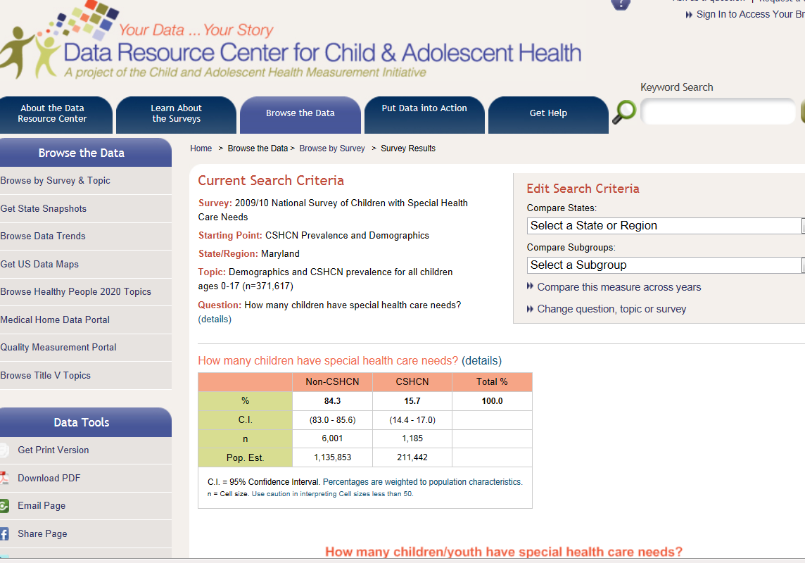
Prevalence and More at State Level
http://childhealthdata.org/browse/survey

Slide 23
How Can I Get Low Cost Data at the Community Level Targeting People with I/DD and Other Disabilities?
Consider collecting it yourself using a Community Concerns Reporting Survey
http://www.ilru.org/html/training/webcasts/handouts/2013/08-15-CIL-NET/081513_presentation.pdf

Slide 24

How to Best Assess Community Concerns Related to Health Equity for People with Disabilities?
Developing a Concerns Inventory http://ctb.ku.edu/en/tablecontents/section_1045.htm
Concerns inventories are a form of community assessment in which people are asked to identify the most important issues facing their community in a given area and how satisfied they are with how the issues are being dealt with
Results can be used to help form strategies to deal with the community's problems and help set an agenda that reflects people's concerns
Costs vary but could be as high as $12,000 - $20,000 depending on community size, target sample, and how findings intend to be used.

Slide 25
Recap
Census data might be your first choice
CDC’s DHDS is an effective and interactive state level disability data tool that can allow you to:
  View health data for adults with and without disabilities
  Map & Download Data Tables (by topic)
  Create State Profiles (by state)
  Identify disparities experienced by people with disabilities
Consider Community Concerns Reporting if some resources might be available.
Notes:
Just to recap what we went over today. DHDS is an interactive online data tool, which provides state level health data on adults with and without disabilities.
Users can view the data in two ways – by topic and by state
DHDS can provide you a lot of information to compare the health of adults with and without disabilities, and allows users to examine the data in several ways. I noticed on the NCSL website that one of the Health Issues getting legislative attention is health disparities – DHDS is a great tool to easily identify and share information on disparities experienced by the population of people with disabilities.

Slide 26
Questions?
DHDS url: dhds.cdc.gov
Michael H. Fox, Sc.D.
imv9@cdc.gov
404 498-3806
For more information please contact Centers for Disease Control and Prevention
1600 Clifton Road NE, Atlanta, GA 30333
Telephone: 1-800-CDC-INFO (232-4636)/TTY: 1-888-232-6348
Visit: www.cdc.gov | Contact CDC at: 1-800-CDC-INFO or www.cdc.gov/info
The findings and conclusions in this report are those of the authors and do not necessarily represent the official position of the Centers for Disease Control and Prevention.
National Center on Birth Defects and Developmental Disabilities
Place Descriptor Here
Notes:
I want to thank you for allowing me to show you DHDS, and I hope that you will find it useful.
Here again is the URL – dhds.cdc.gov.
If you have any questions, or want more information on some of the features that I wasn’t able to highlight today, please feel free to email our team at dhds@cdc.gov. We will be happy to assist you with using DHDS.
We also have some materials on DHDS – a fact sheet with basic information, and an list of health indicators available. I’d be happy to get those to you if you would like them.
If anyone has questions, I’d be happy to answer those now.

Slide 27
Using Smart Technologies to Create Low-Cost Participatory Research Strategies for Improved Health Literacy and Health Promotion for People with Intellectual and Developmental Disabilities
AUCD Annual Conference
Tuesday, November 19, 2013

Slide 28


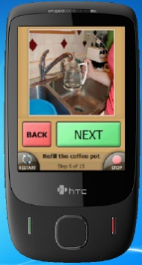
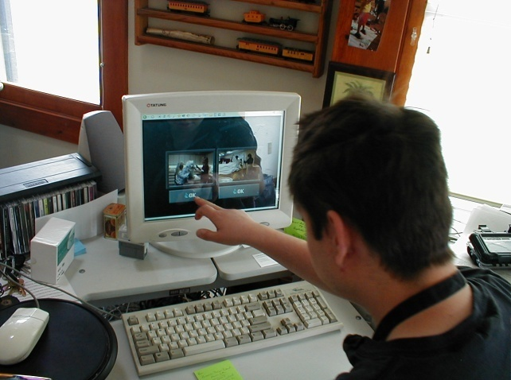






Tele-Health: Existing and Emerging Technology Platforms
The User Interface is the Key (Software)

Slide 29


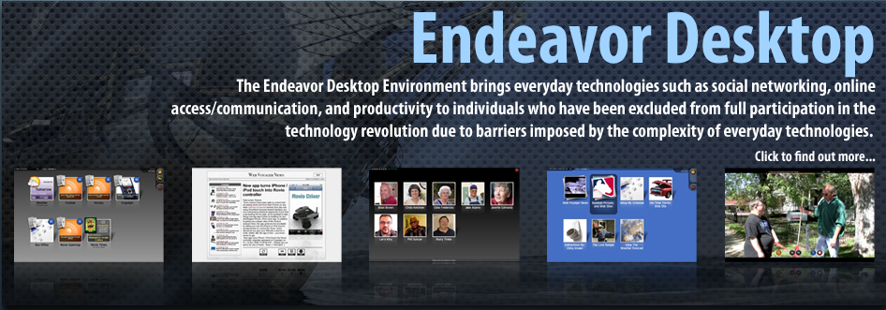
Cognitively Accessible
Windows or Macintosh Computing Environment

Slide 30

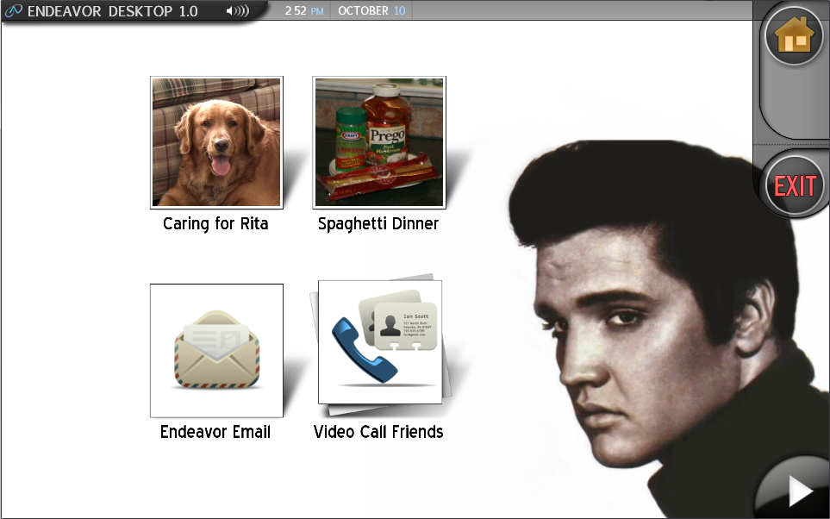
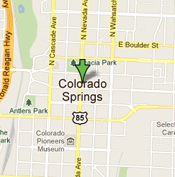
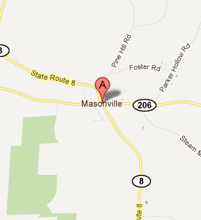
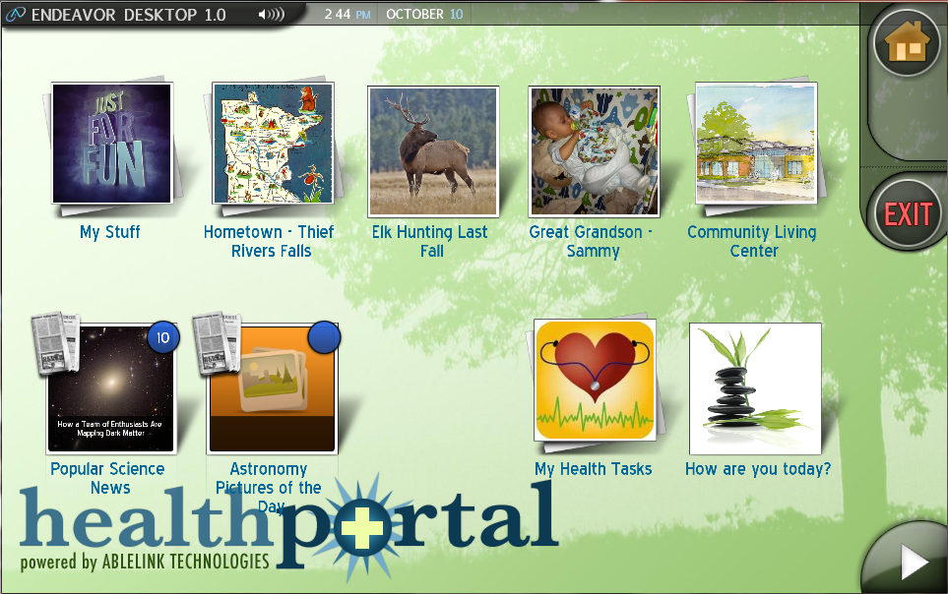

Desktops are Driven by Personal Interests and Needs

Slide 31

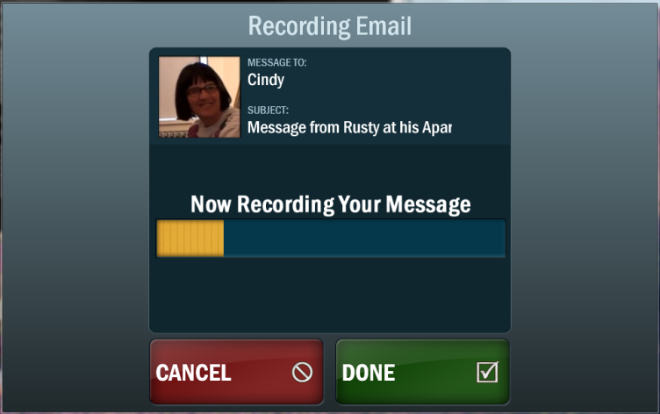
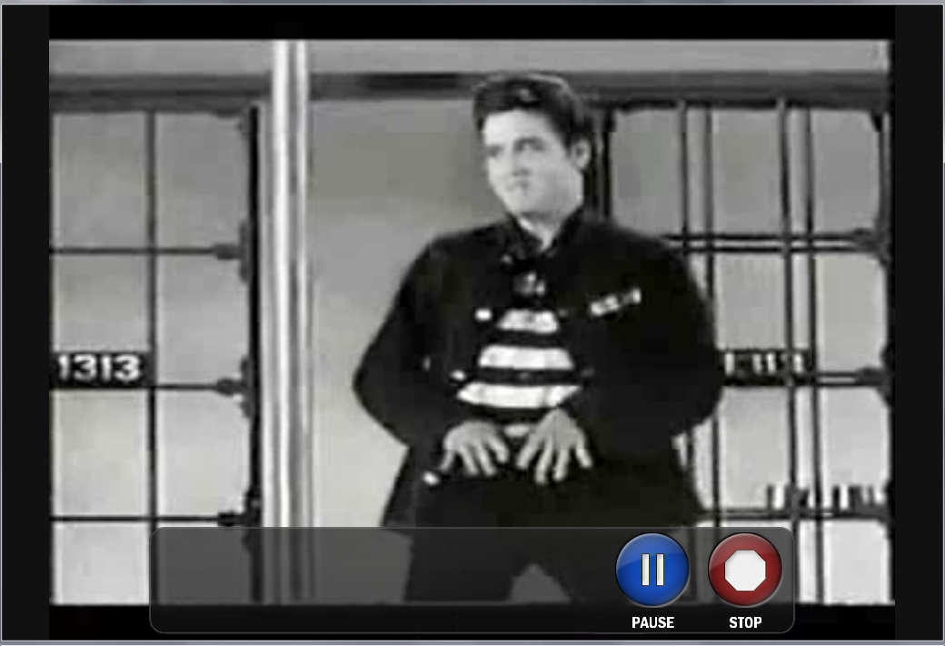
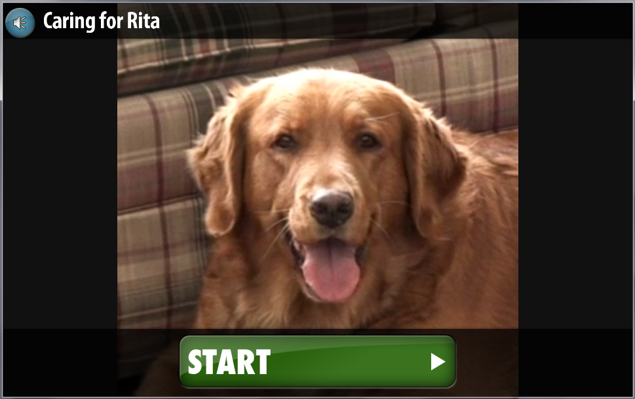
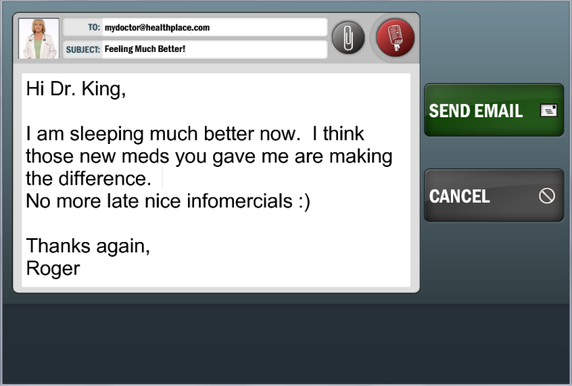
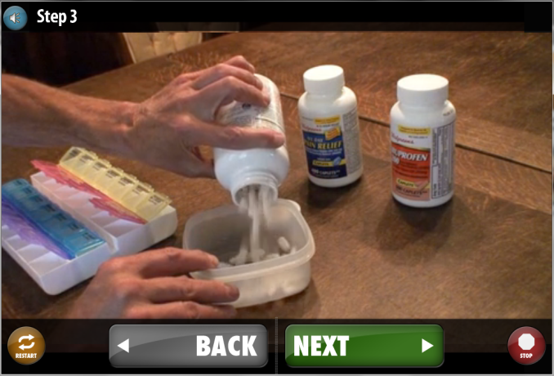

Accessibility Settings Applied to Each User via the Cloud

Slide 32
Type 2 Diabetes and People with I/DD
Data from 2006 Medical Expenditures Panel Survey
  Health status of working age adults with cognitive limitations compared with adults with no disability
  Adults with I/DD significantly higher prevalence
    19.4% vs 3.8%
  Also significantly higher prevalence 6 other chronic health conditions
  Adults with I/DD and diabetes significantly more likely to have 4 or more chronic illnesses
  Reichard & Stolzle (June, 2011). Diabetes among adults with cognitive limitations compared to individuals with no cognitive disabilities. Intellectual and Developmental Disabilities 49 (3), p 141-154.

Slide 33
Health Literacy
Institute of Medicine workshop reports:
  Promoting health literacy to encourage prevention and wellness (November 1, 2011)
    Research to find better pathways to improved health literacy and better health
  Innovations in health literacy (March 10, 2011)
    Health literacy and health disparities, better use of IT improve health literacy
  Overall nearly nine out of 10 adults have difficulty using health information to make proper health decisions

Slide 34
Premature Deaths of People with Learning Disabilities
Data from a study between 2010 and 2012 in the UK
  Looked at the causes of death among all known deaths among people with learning disabilities in the Bristol area of south-west England
  Men with learning disabilities died, on average, 13 years sooner than the general population
  Women with learning disabilities died, on average 20 years sooner than the general population
  Overall, 22% of the people with learning disabilities were under 50 at the time of death compared with just 9% of the general population
  “The cause of their premature deaths appears to be because the NHS is not being provided equitably to everyone based on need. People with learning disabilities are struggling to have their illnesses investigated, diagnosed and treated to the same extent as other people.”
  Heslop, et al, (March 19, 2013). Confidential inquiry into the premature deaths of people with learning disabilities. Norah Fry Research Center, Bristol University, England. http://www.bris.ac.uk/cipold/fullfinalreport.pdf

Slide 35
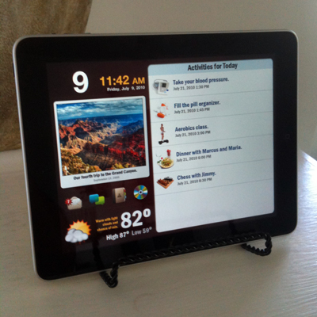
HealthCare Manager – Personalized Health Plan on iPad

Slide 36
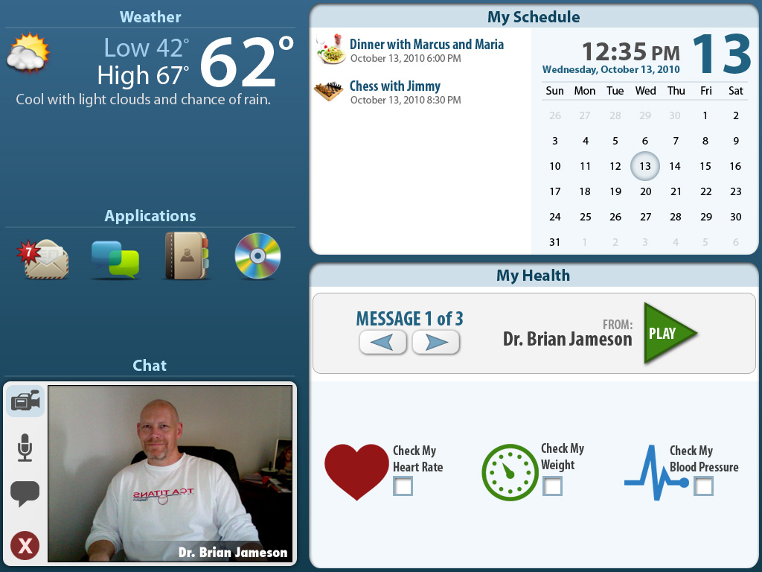
Cognitively Accessible Telehealth Portal - iPad/Android

Slide 37
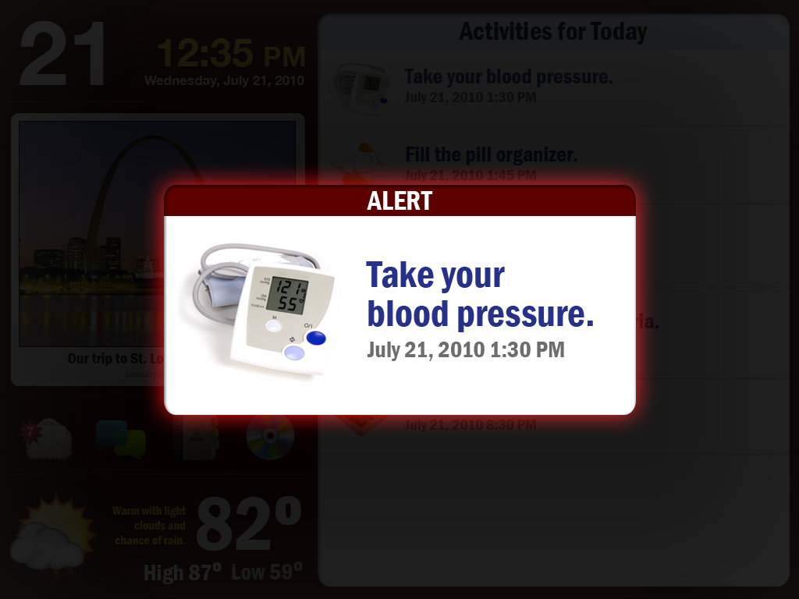
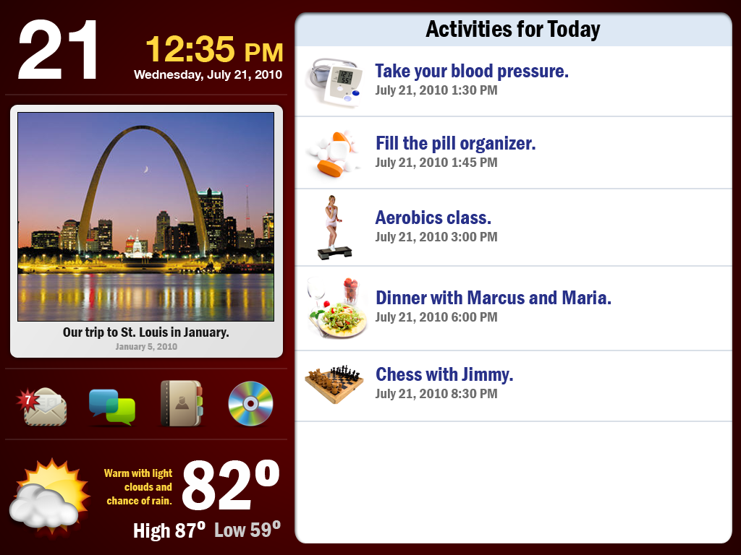

Slide 38
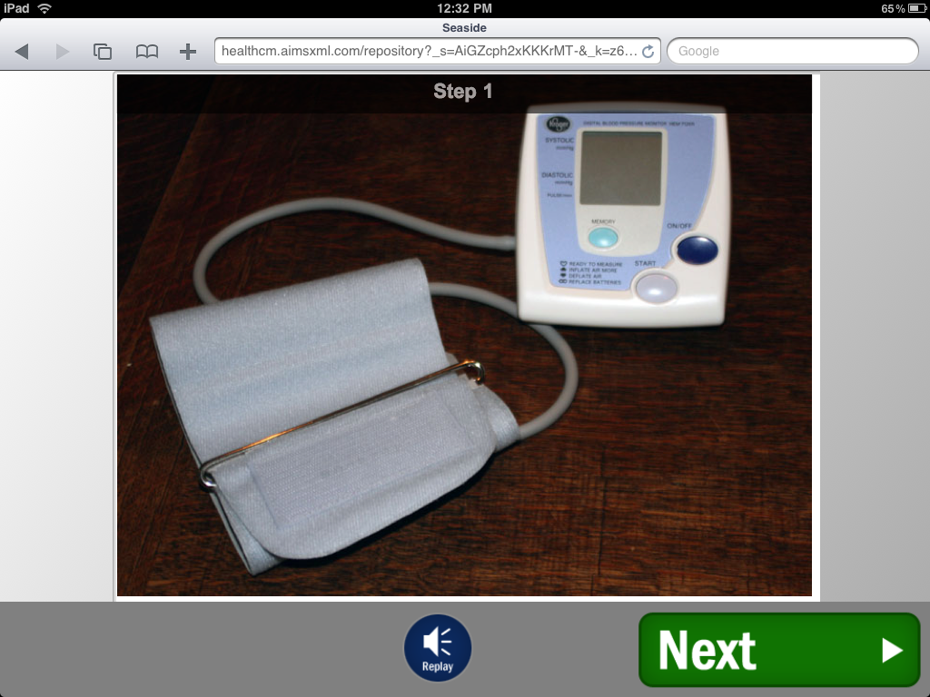
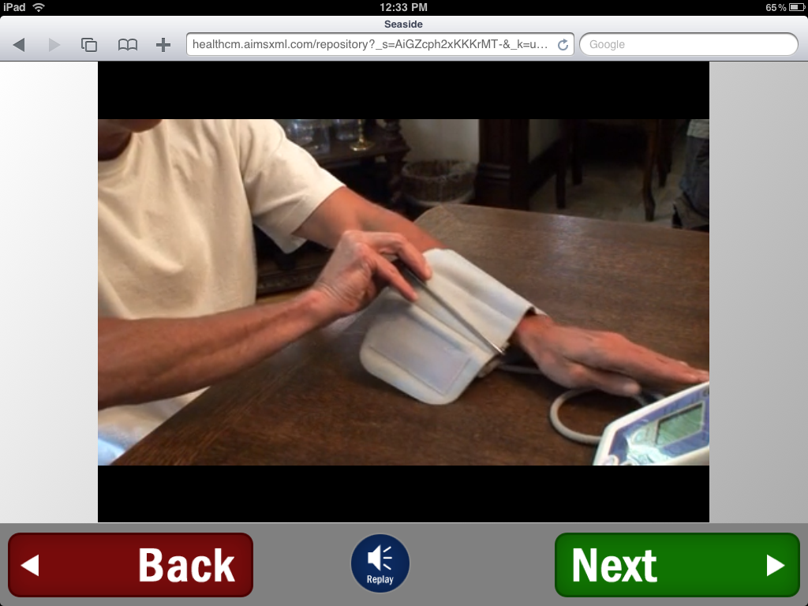

Slide 39
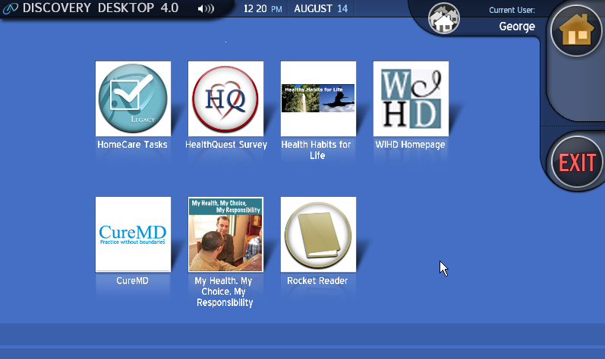
Cognitively Accessible Telehealth Portal – Desktop/Touchsmart

Slide 40
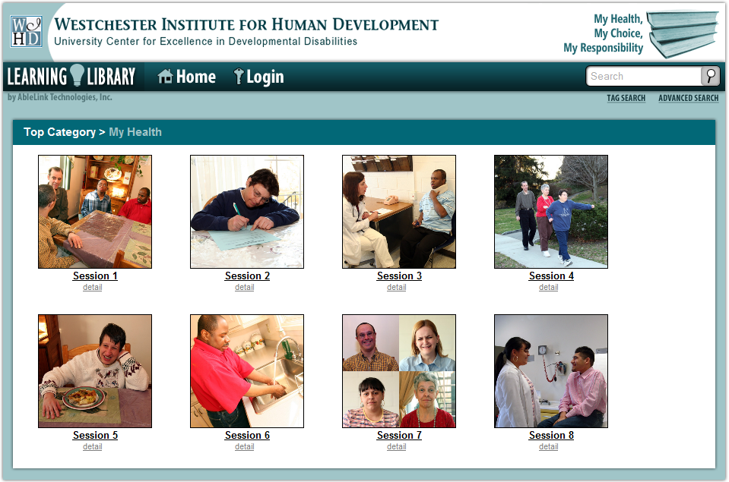

Slide 41
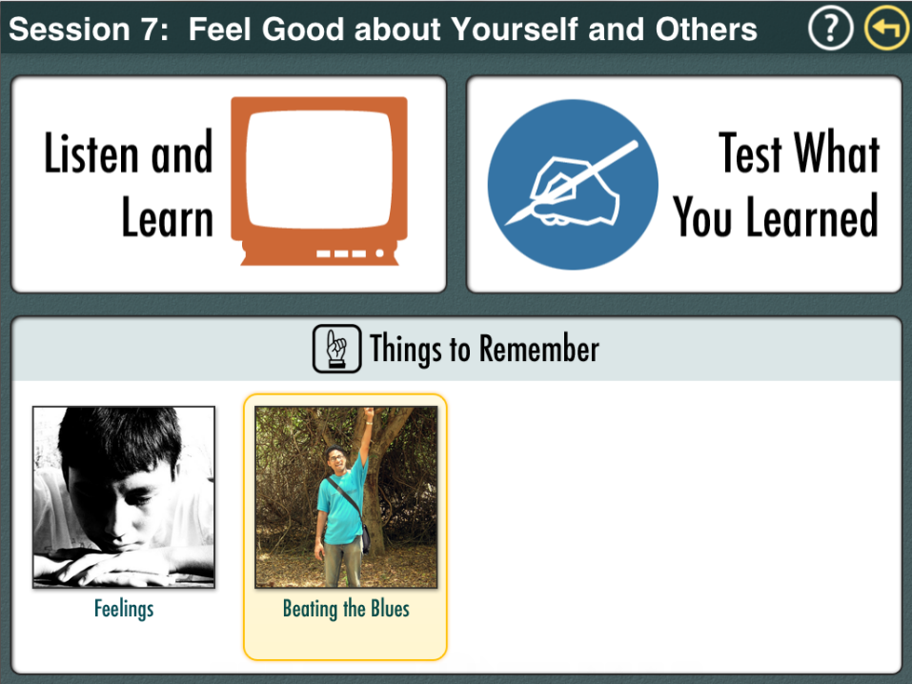

Slide 42
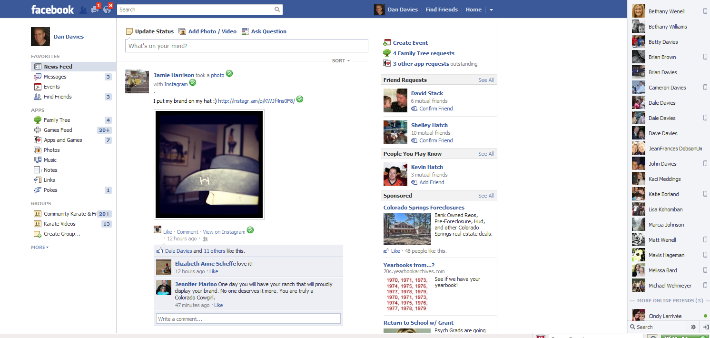
Facebook: Powerful Opportunity to Connect

Slide 43
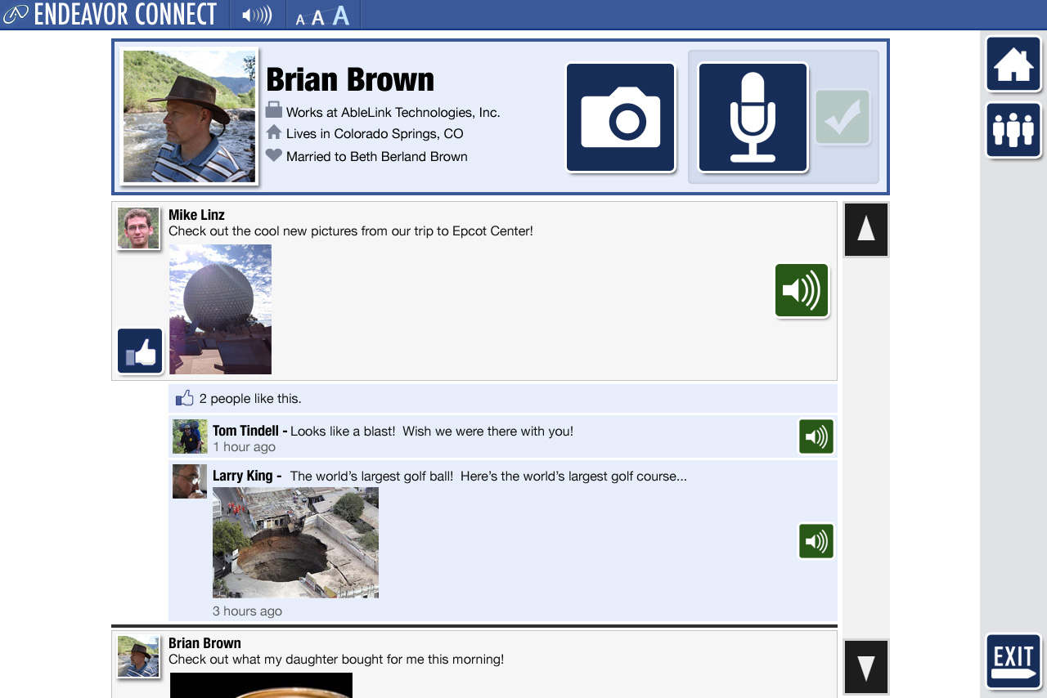
Endeavor Connect: Cognitive Access to Facebook

Slide 44
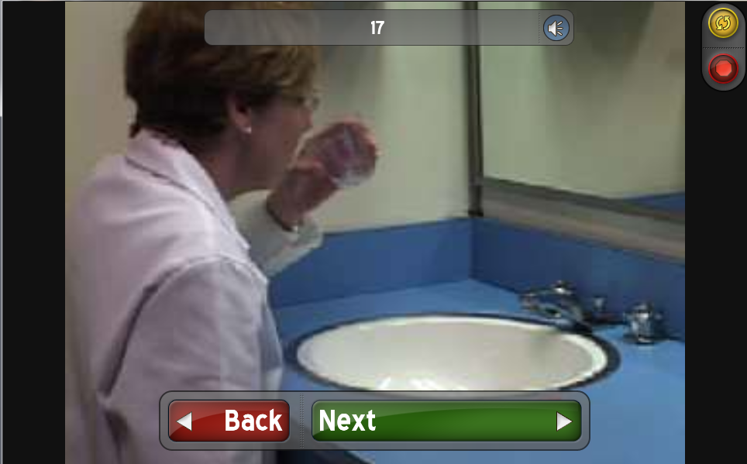
Improving Oral Health

Slide 45

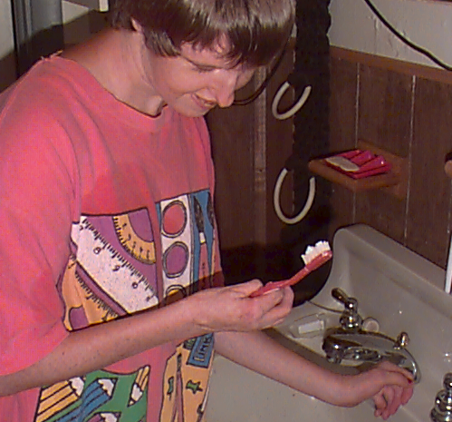
Janice after you eat every meal you need to go brush your teeth and you need to get your brush and your toothpaste and go to the bathroom

Slide 46
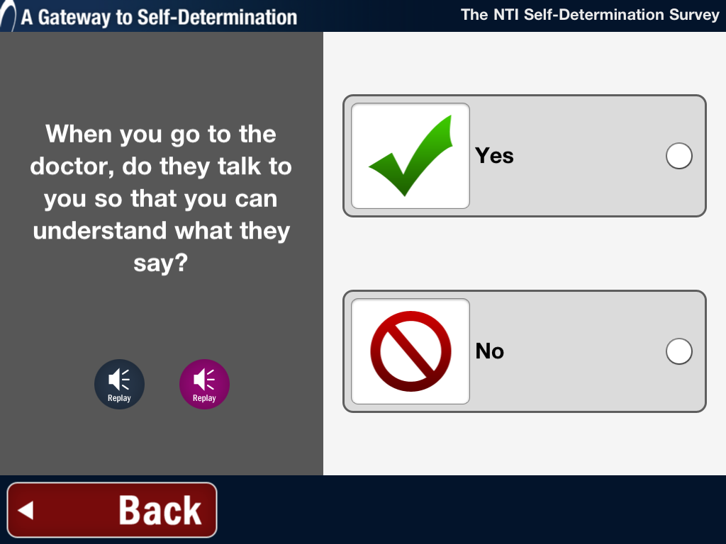
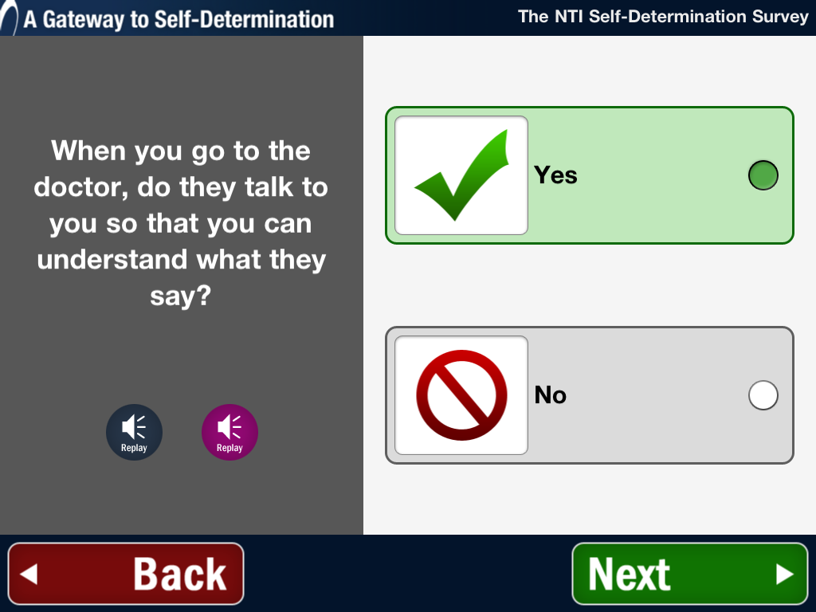
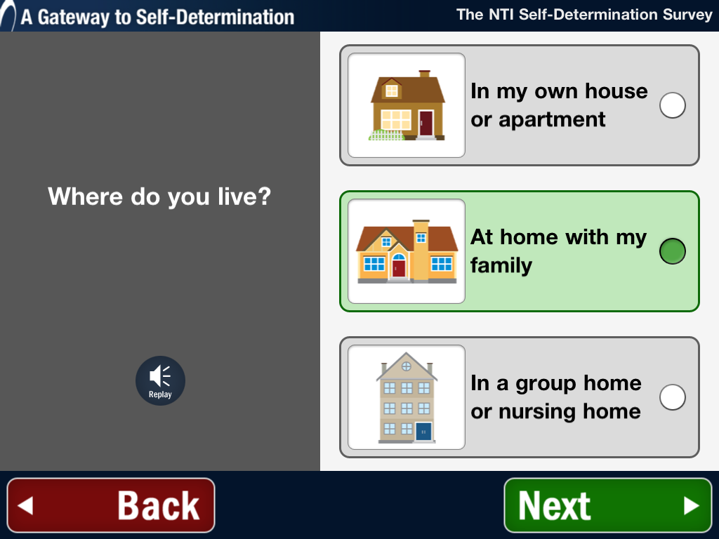
Self-Directed Consumer Surveys
Self-directed, survey tools , such as consumer satisfaction surveys, using multi-modal presentation and accessible design can increase independence and reduce staff time interviewing and entering/ aggregating data.
ATLAS – Accessible Testing Learning & Assessment System

Slide 47
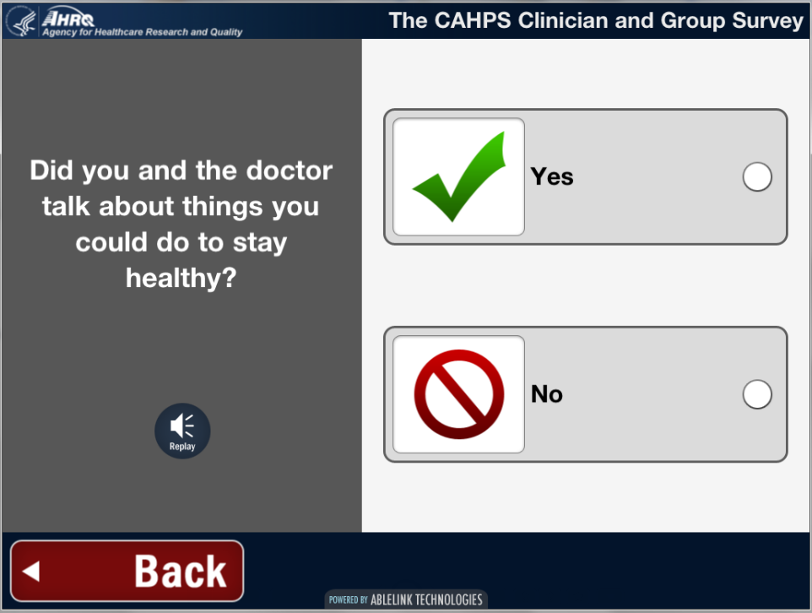

Slide 48


Slide 49

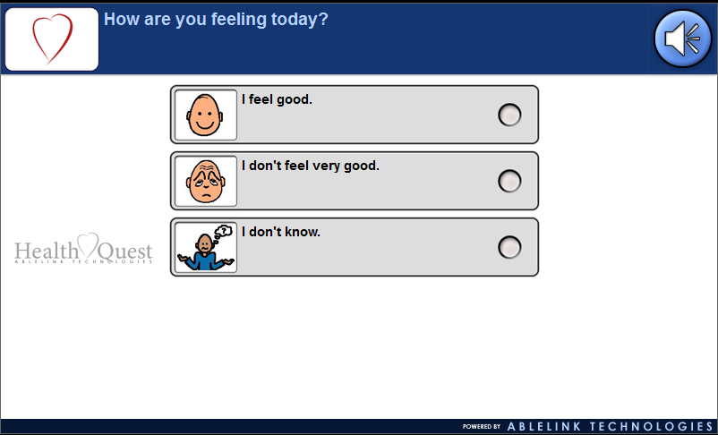
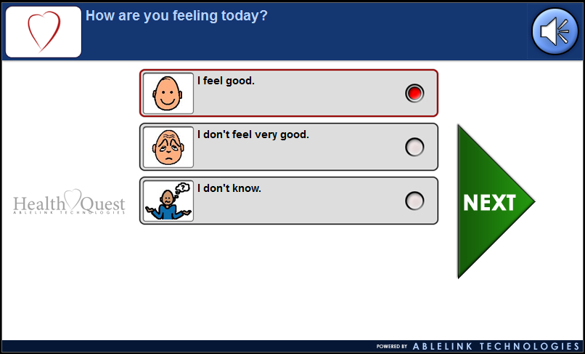
Health Quest
An accessible survey tools to enable individuals with cognitive disabilities
to become active participants in their own health and wellness.

Slide 50
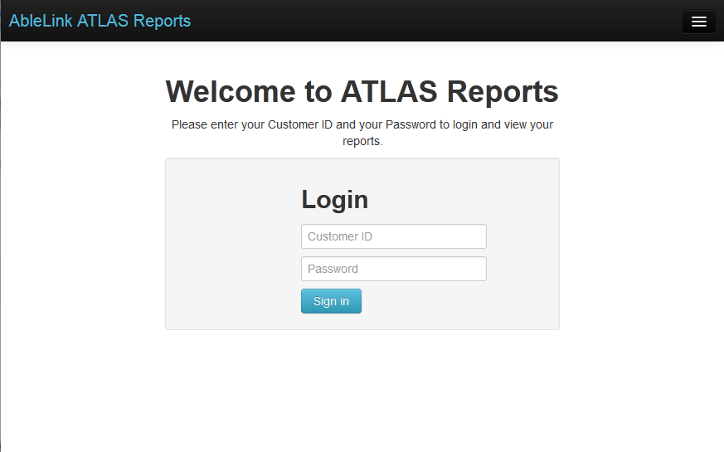
Access to Cloud-Based Data

Slide 51
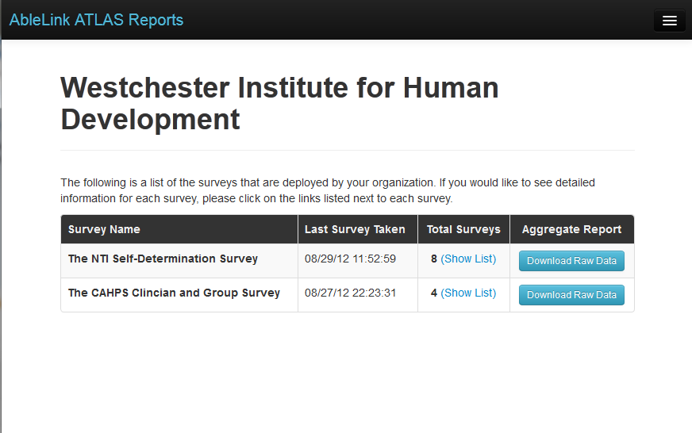
Survey Response Summary

Slide 52
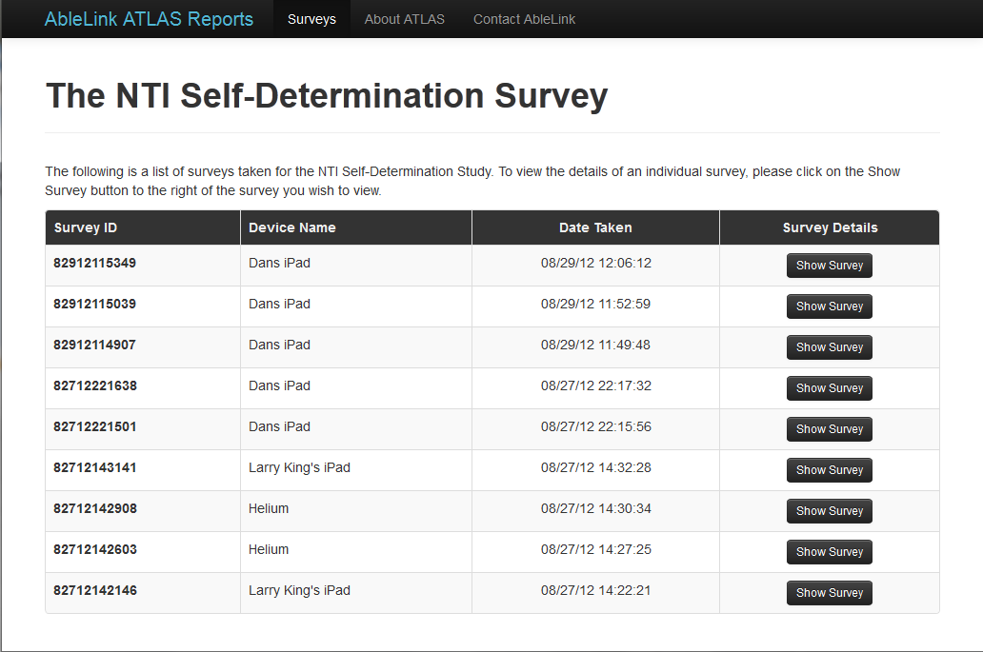
Survey Response Detail

Slide 53
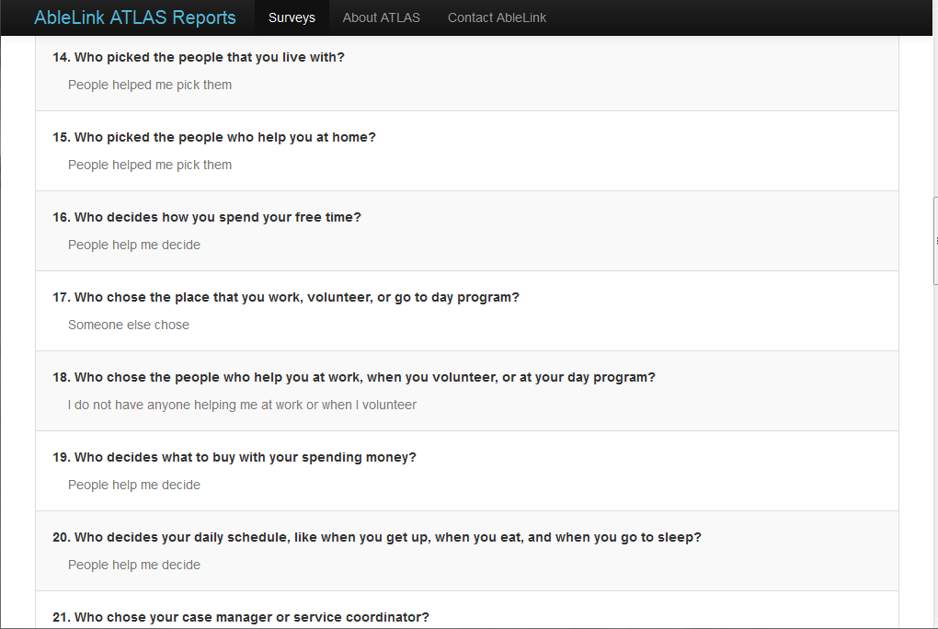
Individual Responses

Slide 54
Future Projects
Submitted research proposal under the health literacy initiative to NIH for evaluation of the effectiveness of using smart technology to improve the oral health of people with I/DD.
Develop and deploy accessible health education, health promotion and wellness resources through currently available EMR’s
Integrate patient satisfaction survey into WIHD PCMH model
Use smart technologies to support transitions for young adults with I/DD from pediatric to adult health care

Slide 55
Presentation: Low Cost/No Cost Solutions for Health Activities in your UCEDD
Strategies to increase health & awareness
for individuals with disabilities & their families
Elena M. Andresen, PhD
Institute on Development & Disability
Oregon Health & Science University UCEDD
Oregon Office on Disability & Health
Angela Weaver, MEd
Institute on Development & Disability
Oregon Office on Disability & Health
November 19th, 2013

Slide 56
Funding & Acknowledgments
OHSU Center for Excellence in Developmental Disabilities (UCEDD); Administration on Developmental Disabilities 90DD0684 01
Oregon Office on Disability & Health (OODH); CDC National Center on Birth Defects & Developmental Disabilities 1U59DD00942-01
Oregon staff & disability communities of the OODH & UCEDD

Slide 57
Overview
We live in a US era with fiscal constraints
  Partnerships & leveraging funds are imperative to provide services & improve health in our communities
Healthcare transformation generates renewed & vigorous focus on prevention
  Fosters public health agency partnerships
  New partners in some states: Affordable Care Act’s Accountable Care Organizations
Oregon provides examples & resources
  Oregon Office on Disability & Health (OODH)
  Coordinated Care Organizations (CCOs) & other state entities

Slide 58
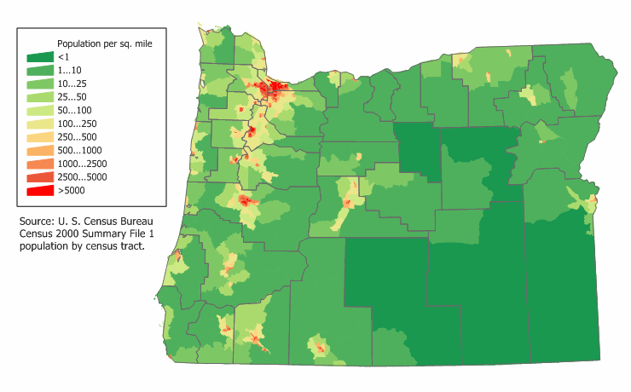
Oregon Context: Population Density/Rural &
Frontier status

Slide 59
Example partners for our health & healthy lifestyles activities
Oregon Health Authority
  Our ACA healthcare transformation agency, including Coordinated Care Organizations
  Chronic Disease/Health Promotion
Centers for Independent Living
Brokerages
Oregon DD Council
Department of Human Services
  Ageing & Persons with Disability

Slide 60
Example of our breast health/health care accessibility activities
States’ vary: Our list demonstrate the groups you may need to partner with for health projects
Oregon Partnership for Cancer Control’s Breast Health Task Force
  Susan G. Komen of Oregon & SW Washington
  State-level Breast & Cervical Cancer Program
  Oregon’s Genetics Program
  OHSU (academic) Cancer Knight Institute
  American Cancer Society
  Other state hospitals cancer center programs
  County Health Departments
  State-wide Komen grantees

Slide 61
Oregon breast health & health care accessibility activities
Provided on-site ADA accessibility assessment of 75/105 Oregon mammography facilities
  Standardized assessment
  “Path of travel:” parking lot to screening room
Created site recommendation plans
Created on-line resource for women
2013, new extension to Project Accessibility USA with:
  University of New Mexico
  Am. Assc. on Health & Disability
  Komen Foundation

Slide 62

Oregon Aging & Persons with Disability program opportunities
National leadership to move from Area Agencies on Aging (AAA) to Aging & Disability Resource Centers (ADRCs)
Oregon ADRCs partnerships
  Centers for Independent Living (CILs); referral/service across the adult lifespan
  The statewide public facing website & searchable resource data base with over 6,000 resources for consumers & families www.ADRCofOregon.org

Slide 63
Oregon Chronic Disease
(Health Promotion)
Three year grant from Agency on Aging to the Oregon Health Authority
  Partnership between OODH & OHA
  Incorporate people with disability into the “Living Well” Stanford disease management training
  All state health departments have some version of a health promotion/disease management program
  Mini-grants to Oregon ADRCs to partner with their local CIL
  Uses Train-the-Trainer model: includes disability lay trainers
  Strong focus on improving program accessibility
Example of adding disability capacity to an ongoing state public health program

Slide 64
Affordable Care Act Opportunities:
Oregon example
Training people with disability to engage in CCO (Oregon’s ACOs) Boards & training CCOs to engage PWD for health promotion.
  Private foundation funding to the state DD Coalition
  Incorporate people with intellectual disability who can serve as a resource for CCOs
  Educate CCOs on disability
Example of adding disability capacity to the State’s Healthcare Transformation with their focus on communities, disparities, & health promotion/ disease prevention

Slide 65
Health Promotion Activity: Tobacco
Cessation
Adults with disabilities smoke more
  Nationally: 25% PWD current smokers versus 18% of other adults
  Oregon: 23% PWD versus 17% of other adults
  Be aware of your state figures to approach & partner with your state health department
Opportunity: Oregon Tobacco Quit Line
  New disability identifier question in the demographic intake (data-driven public health!)
  OODH created a tobacco cessation brochure targeting people with disability & developmental disability
  We will target outreach to CILs & Brokerages, with tracking of their referrals to the Quit Line

Slide 66
OODH health promotion materials

Slide 67
OODH materials demonstrating inclusion

Slide 68
OODH materials demonstrating inclusion

Slide 69
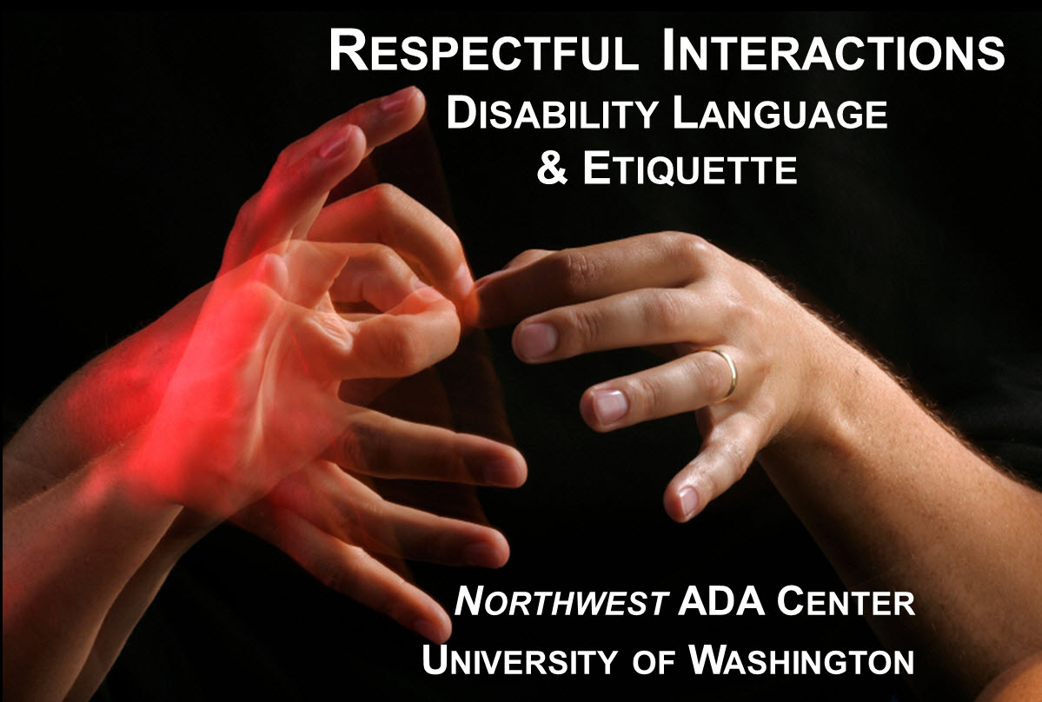
Regional ADA Centers can help
OODH/Northwest ADA Center partnership
  Coming soon: updated disability sensitivity training – on line with certificate possible
  Respectful Interactions offers respectful, practical advice on serving customers and working alongside colleagues who have disabilities
  In Oregon, provided to
  health department
  staff

Slide 70
Final thought about free & low-cost programs for health & health activities
When a door opens, go through it & offer to work with those who were behind the door

Slide 71
Contacts
Elena M Andresen, PhD: OODH Director
Office: 503-494-2275 : andresee@ohsu.edu
Angela Weaver, MEd: OODH Project Coordinator
Office 503-494-1205 weaverro@ohsu.edu
See our web-based health survey for Oregonians with disabilities at http://oodh.healthassessment.sgizmo.com/s3
Visit our OODH website for materials & details about health promotion & other activities at www.oodh.org

Slide 72
Other resources to promote inclusion
Approach your health department to use appropriate graphics
  Image library: Florida Office on Disability & Health http://fodh.phhp.ufl.edu/training-resources/inclusive-image-library-photo-release/
Learn/partner with local, national VA Healthcare facilities & resources
Training to improve healthcare & health promotion access (resources page)
  We tend to avoid the medical model
  Learn about them to improve your partnerships!
  Partner with agencies that serve older adults

Slide 73
Clinician/Healthcare Training Resources
Western University Center for Disability & Health Policy. Educating health professionals on disabilities. Pomona, CA: http://www.westernu.edu/xp/edu/cdihp/cdihp-resources-professionals.xml
Smeltzer & Sharts-Hopko. Provider’s guide for the care of women with physical disabilities & chronic health conditions. Chapel Hill: NC Office on Disability & Health. http://www.fpg.unc.edu/~ncodh/pdfs/providersguide.pdf
Barker LT, et al. Practitioners’ guide to primary care for women with physical disabilities. Berkeley, CA: Berkeley Policy Assoc/Alta Bates Summit Medical, 2005. http://www.berkeleypolicyassociates.com/images/berkeleypolicyassociates.com/Image/photo/20050707_193250/Booklet.pdf
Havercamp S. CDC web-based training modules. Healthcare access for persons with disability. Part I: physical & sensory disabilities. Part II developmental disabilities. http://nisonger.osu.edu/disabilityconted.htm.
Aging & Disability Network Participant Direction Toolkit (an element in the Affordable Care Act). http://www.bc.edu/content/bc/schools/gssw/nrcpds/tools/toolkit.html.
Chun A (Ed). Geriatric care by design. A clinician’s handbook to meet the needs of older adults through environmental & practice redesign. Am Medical Assoc, 2011.

Slide 74

Promoting Accessible, Inclusive Fitness and Outdoor Recreation
Partnerships and No-cost/Low-cost Strategies
Eileen Sparling, Ed.M.
Center for Disabilities Studies

Slide 75
Background
CDC Disability and Health Grantee focused on improving health access, health promotion and emergency preparedness for people with disabilities
Funding since 2007
  One Goal: Reduce barriers that prevent full access to healthy living in the community.

Slide 76
Strategic Partnerships & Technical Assistance
Align with partners who have healthy living goals
Identify contacts with responsibility for accessibility
Identify and address gaps in knowledge and resources
Provide tools, models and resources to help meet inclusion goals

Slide 77


A Tale of
Two Partners

Slide 78
YMCA of Delaware
YMCA of Delaware is the only statewide YMCA
Nine branches, over 2,800 staff, 1,300 volunteers
Reaches one out of every four households in Delaware
One tenth of Delaware’s population is a member
Goals include healthy living for all Delawareans

Slide 79
YMCA of Delaware
Identify and address barriers in facilities and programming
Promote staff and volunteer training on inclusion
Identify resources for accessible equipment
Provide TA on inclusive policies

Slide 80
YMCA of Delaware
Activities
TA to Y leadership re: accessibility, effective communication
Developing an online inclusion training for volunteer sports coaches (through external funding from DD Council).

Slide 81
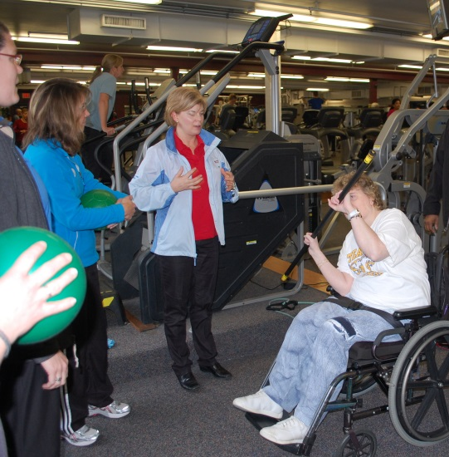
YMCA of Delaware
Offered workshop for fitness trainers conducted by the National Center on Health, Physical Activity and Disability.
  The Inclusive Fitness Trainer Workshop was attended by 38 trainers
  95% of participants showed increase in knowledge of disability awareness and accessible facility design
  Shared resource materials related to accessible fitness equipment and accommodations

Slide 82
Delaware State Parks
15 state parks and related preserves and greenways throughout Delaware totaling more than 20,000 acres
Principles of Operation include:
  State parks and preserves are managed for Delaware's residents and visitors, and shall be both accessible and affordable to all segments of society.

Slide 83
Delaware State Parks
Promote accessibility in state parks
  Identify and expand accessible amenities in parks
  Include people with disabilities in planning initiatives
  Identify resources for accessible equipment
  Designate staff to address inclusion
  Promote staff training on accessibility and inclusion

Slide 84
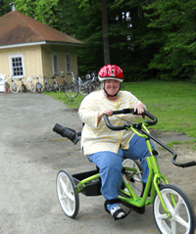
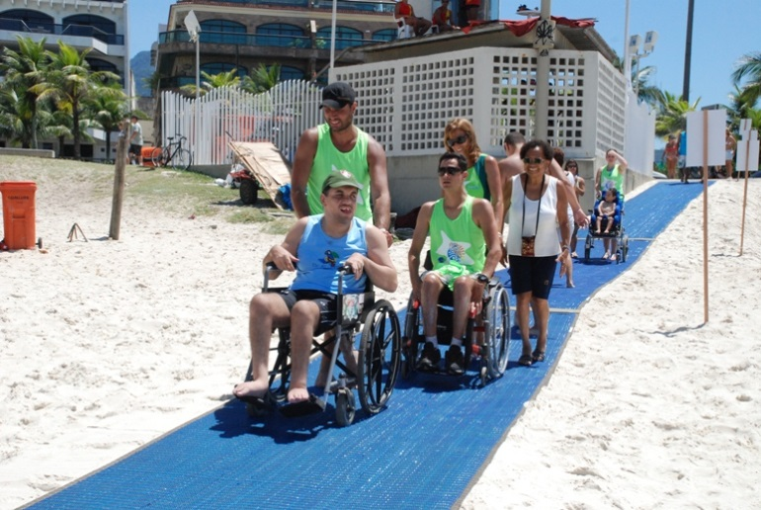
Delaware State Parks
Activities
Representation on the Statewide Comprehensive Outdoor Recreation Plan Technical Advisory Committee and Trails Planning Committee
Instrumental in expanding the use of accessible equipment
  accessible bikes
  Mobi-mats for beach access for wheelchair users

Slide 85



Delaware State Parks
Activities
Promote staff training through TA mailings

Slide 86
Delaware State Parks
2013 Statewide Comprehensive Outdoor Recreation Plan
Recommendations included:
Create an accessibility guide to all public outdoor recreation spaces
Develop guidance tools that address best practices for universal accessibility to outdoor recreation facilities
Ensure representation from the disability community throughout the conservation and recreation planning processes

Slide 87
Contact Information
Eileen Sparling
Center for Disabilities Studies
University of Delaware
sparling@udel.edu
302-831-8802

Slide 88
Low Cost/No Cost Solutions for Health Activities
In Your UCEDD
QUESTIONS?
Michael Fox
David O’Hara
Elena Andresen
Eileen Sparling

